Slide 1
Feedback Control of an Inverted Pendulum
EE 502 Class Project
Logan Dihel

Slide 2
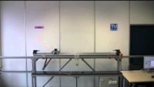
Inspiration
Triple Inverted Pendulum
Tobias Gluck – YouTube (2011)

Slide 3
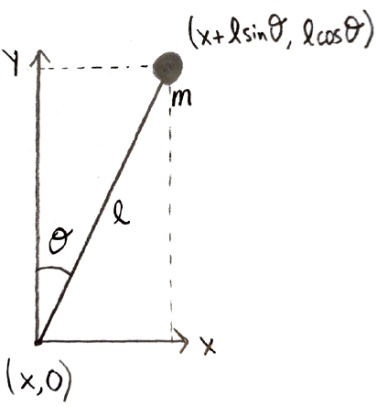
Introduction
Why Study Inverted Pendulum (IP)?
Classic problem in control community.
IP is an unstable, non-linear system.
Evaluation of control architectures.
Goals of this Project
Stabilize IP using SISO/MIMO controllers
P, Lead, LQR, LQG
Investigate real-world implementation details
Transport Delay, Sensor Quantization Noise

Slide 4
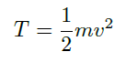
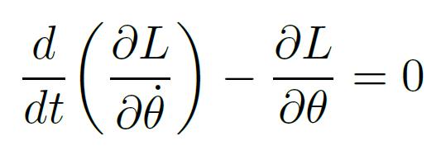
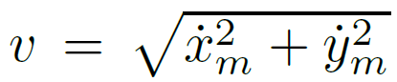
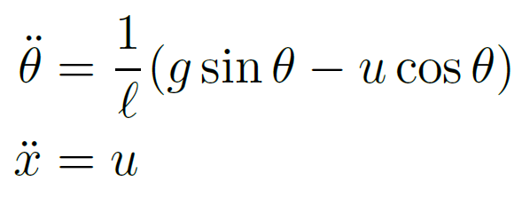
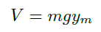
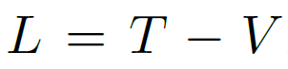
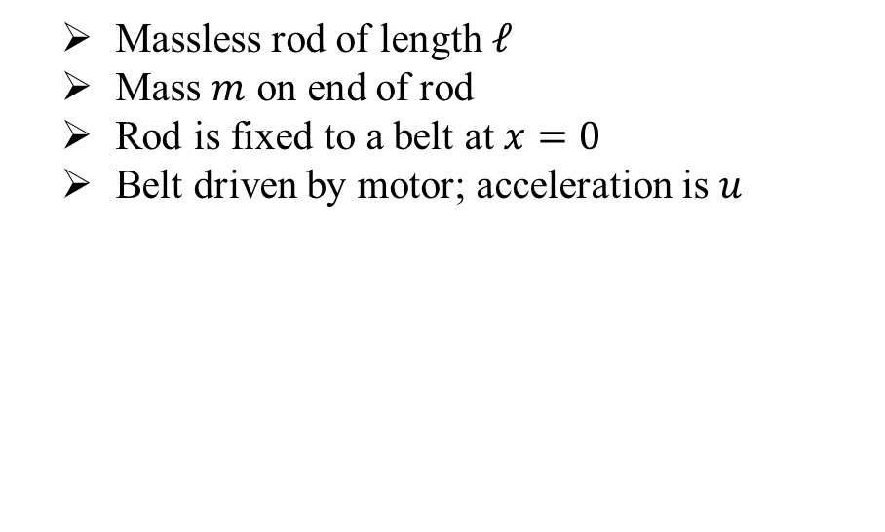
Inverted Pendulum Modeling
Massless rod of length $ℓ$
Mass $m$ on end of rod
Rod is fixed to a belt at $x=0$
Belt driven by motor; acceleration is $u$

Slide 5
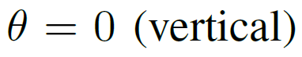
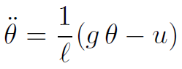
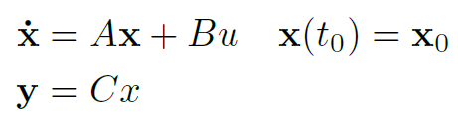
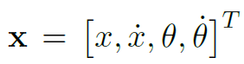
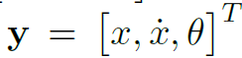
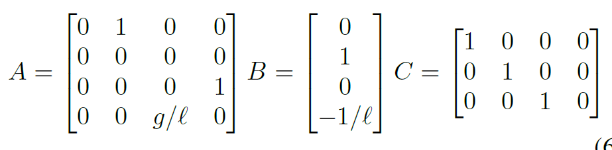
Linearization
Linearize around

Slide 6
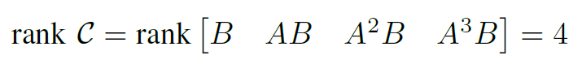
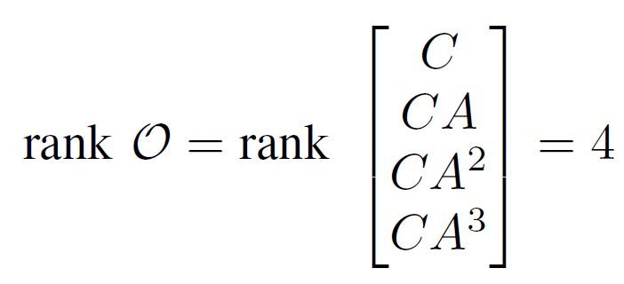
Controllability, Observability
Motor is only system input, but system is controllable
Belt Position, Belt Speed, and Pendulum Angle can be measured
System is observable

Slide 7
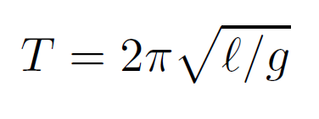
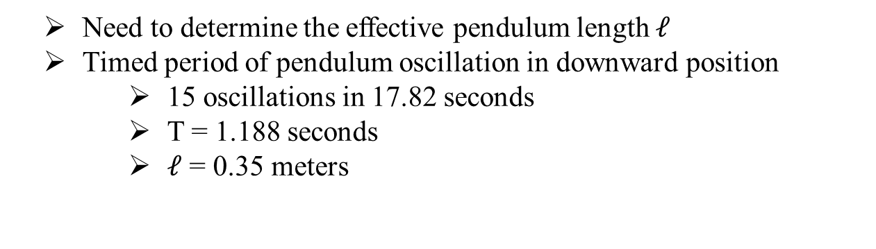
System Identification
Need to determine the effective pendulum length $ℓ$
Timed period of pendulum oscillation in downward position
15 oscillations in 17.82 seconds
T = 1.188 seconds
$ℓ$ = 0.35 meters

Slide 8
Building the Inverted Pendulum

Slide 9
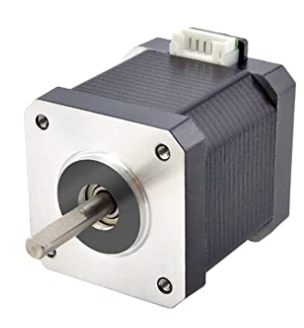
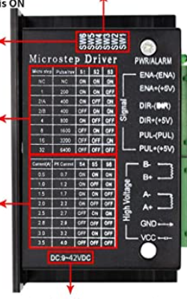
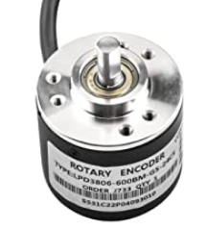
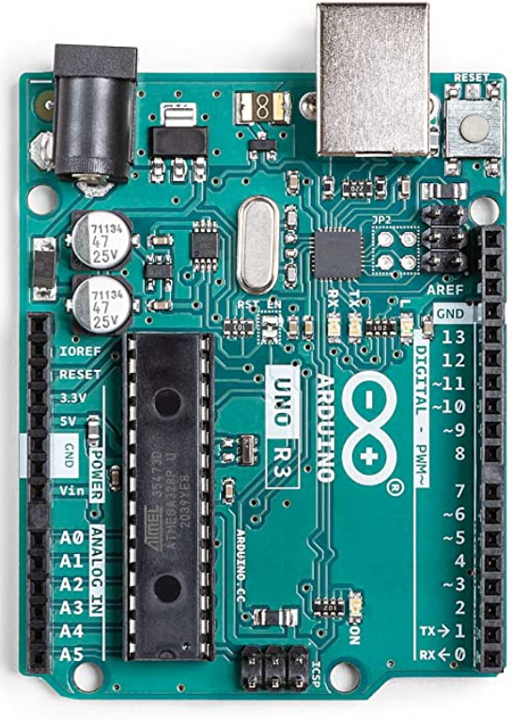
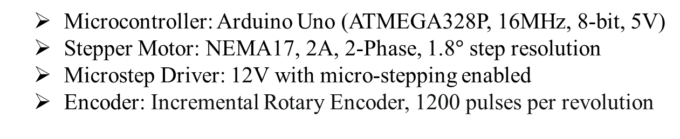
Electronics
Microcontroller: Arduino Uno (ATMEGA328P, 16MHz, 8-bit, 5V)
Stepper Motor: NEMA17, 2A, 2-Phase, 1.8$°$ step resolution
Microstep Driver: 12V with micro-stepping enabled
Encoder: Incremental Rotary Encoder, 1200 pulses per revolution

Slide 10
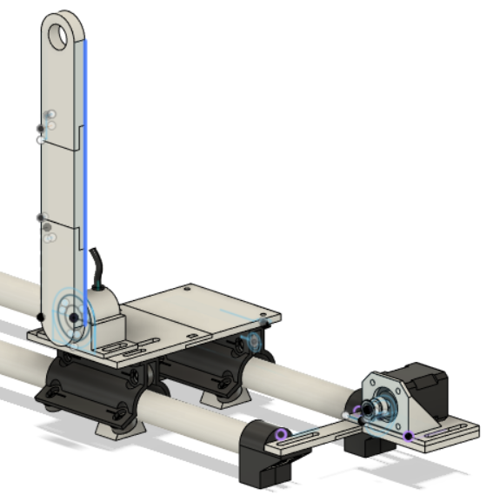
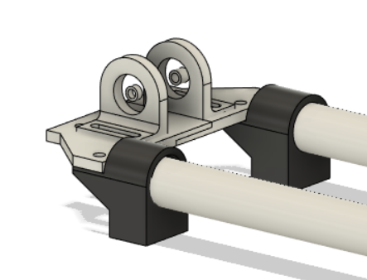
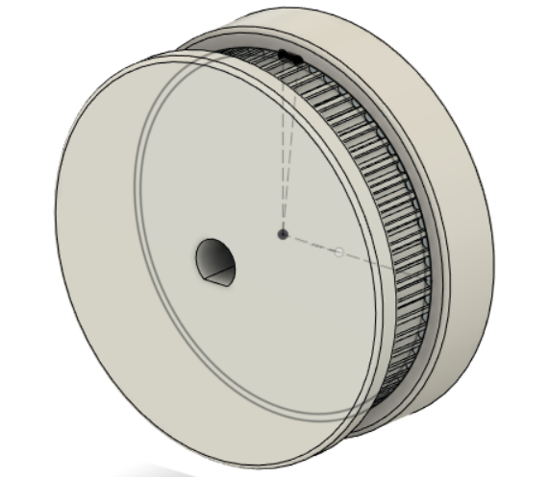
3D Printed Parts
Modeled using Autodesk Fusion360
Printed using PLA 3D Printer Filament
Gantry, Encoder Mount,
Pendulum, and Stepper Mount
Idle Pulley and End Caps
Drive Gear

Slide 11
P Controller Design (SISO)

Slide 12
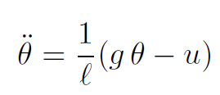
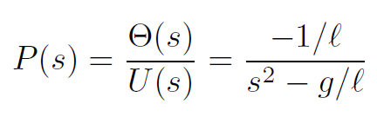
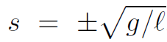
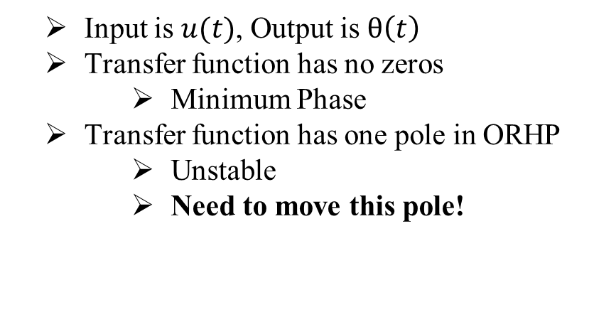
Transfer Function
Input is $u(t)$, Output is $θ\left(t\right)$
Transfer function has no zeros
Minimum Phase
Transfer function has one pole in ORHP
Unstable
Need to move this pole!

Slide 13
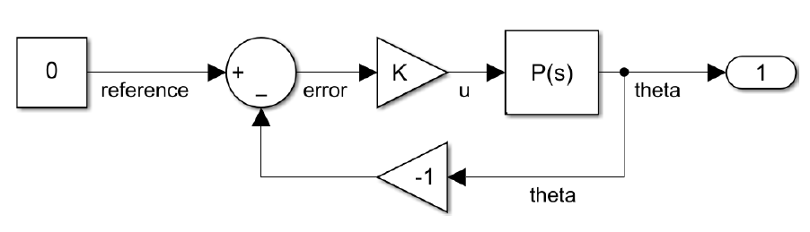
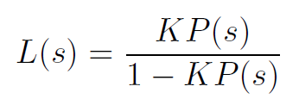
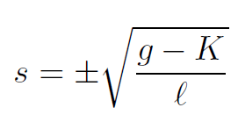
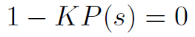
Proportional Feedback Control
Closed Loop Transfer Function
Calculating Pole Locations
Pole Locations

Slide 14
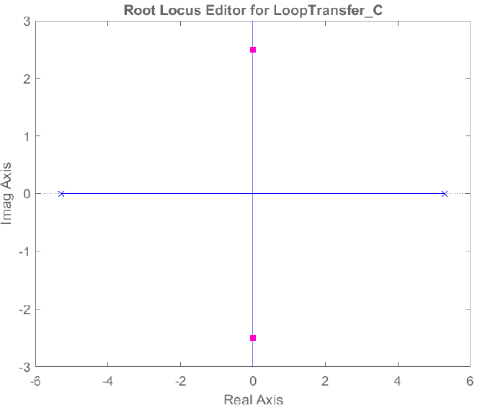
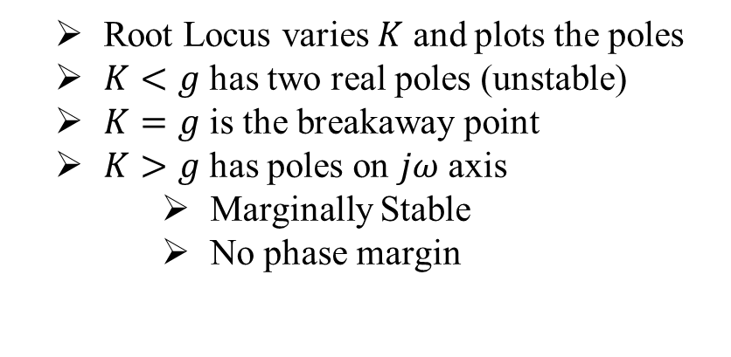
Root Locus, P Controller
Root Locus varies $K$ and plots the poles
$K<g$ has two real poles (unstable)
$K=g$ is the breakaway point
$K>g$ has poles on $jω$ axis
Marginally Stable
No phase margin
K=12
K=9.81
K=0

Slide 15
P Controller Simulations

Slide 16
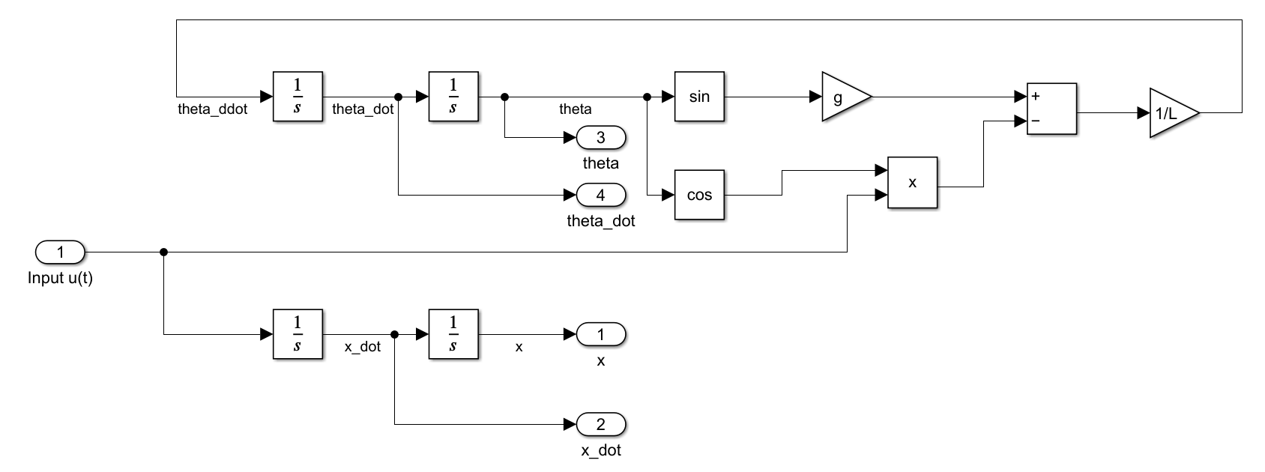
Inverted Pendulum Subsystem

Slide 17
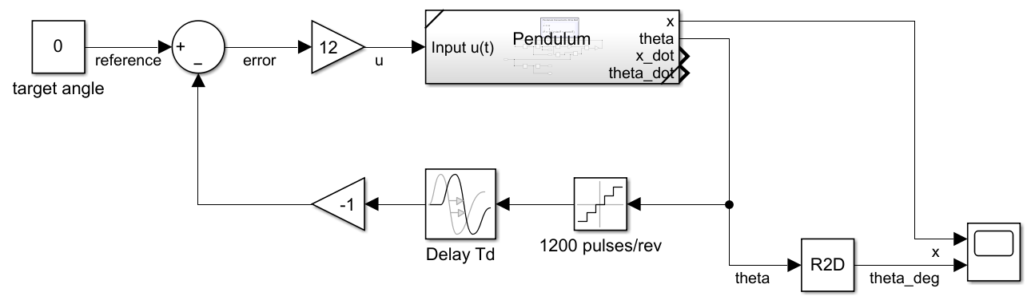
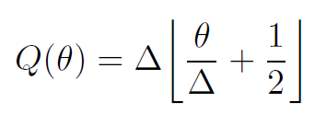
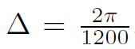
P Controller Simulink Model
Varying K
Adding Delay, Noise
Quantization Noise

Slide 18
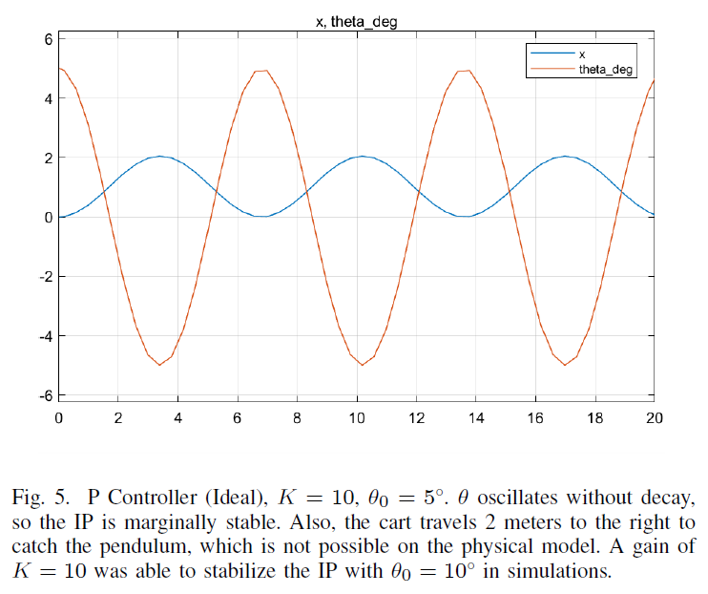
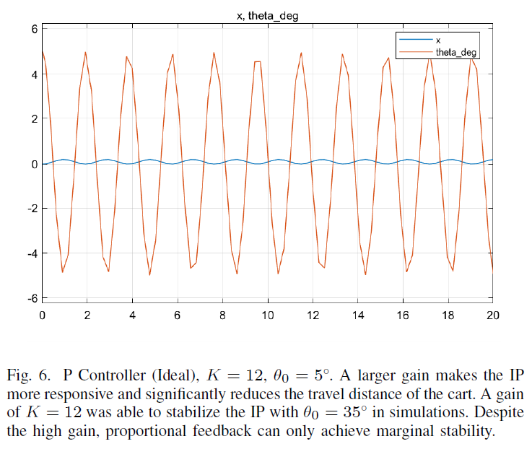
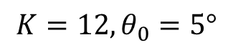
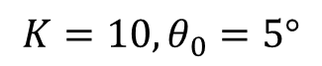
P Controller Ideal Simulations
$$K=10, θ_{0}=5°$$
$$K=12, θ_{0}=5°$$

Slide 19
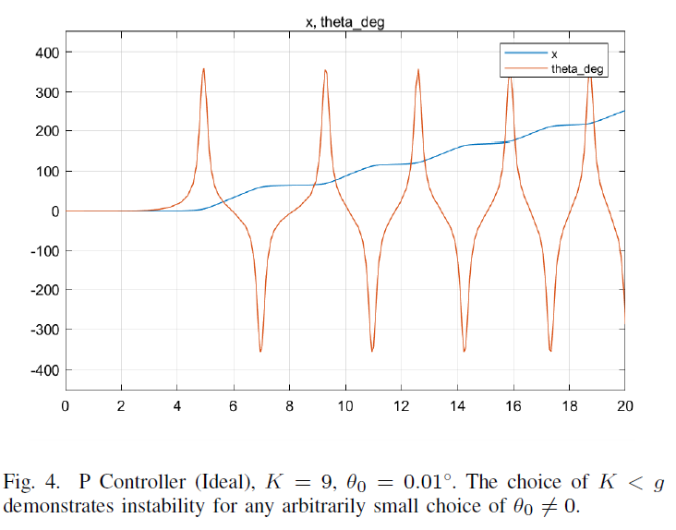
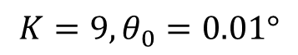
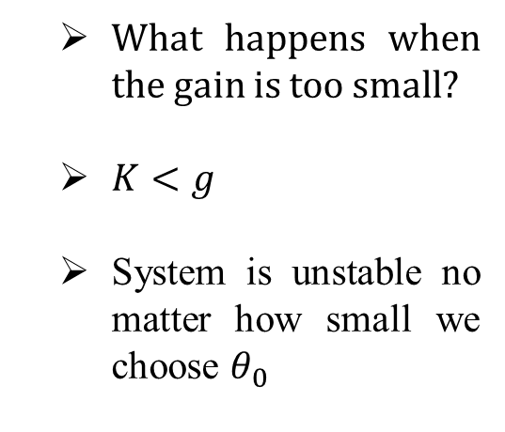
P Controller Ideal Simulations
$$K=9, θ_{0}=0.01°$$
What happens when the gain is too small?
$K<g$
System is unstable no matter how small we choose $θ_{0}$

Slide 20
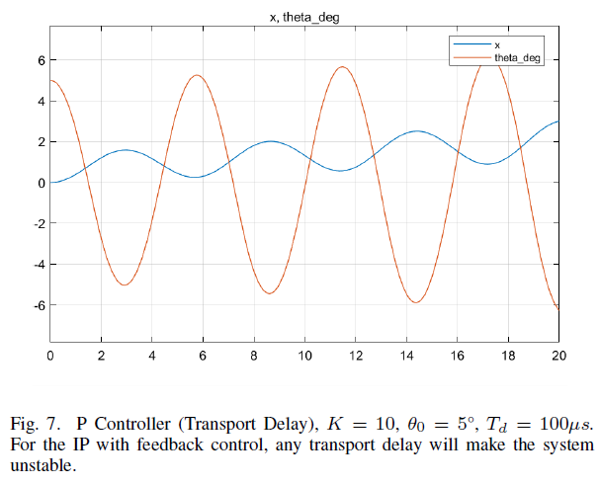
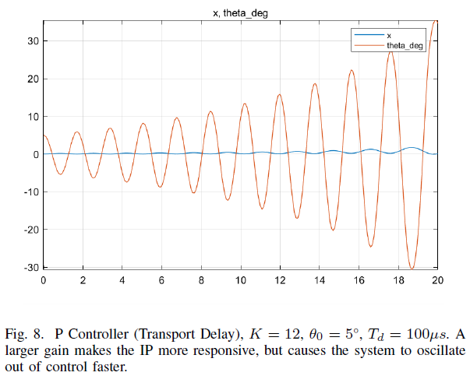


P Controller Transport Delay
$$K=10, θ_{0}=5°,T_{d}=100μs$$
$$K=12, θ_{0}=5°,T_{d}=100μs$$

Slide 21




P Controller Sensor Noise
$$K=10, θ_{0}=5°$$
$$K=12, θ_{0}=5°$$

Slide 22
P Controller Demo
Choose K too small
Cart doesn’t move fast enough
Choose K just right
Oscillations grow slowly
Choose K too large
Oscillations grow quickly
P controller cannot stabilize pendulum
Need to increase phase margin to account for transport delay!

Slide 23
Lead Controller (SISO)

Slide 24


Lead Controller Root Locus
Move the poles away from $jω$ axis
Add a pole and a zero to controller
Lead Controller Root Locus
P Controller Root Locus

Slide 25


Lead Controller Simulink Model
Varying K
Adding Delay, Noise
Choice of $K>39.24$ makes system stable
Choice of $K=50$ produces good transient response and more than 30$°$ phase margin.

Slide 26




Lead Controller Ideal Simulations
$$K=40, θ_{0}=5°$$
$$K=50, θ_{0}=5°$$

Slide 27




Lead Controller Ideal Simulations
$$K=39, θ_{0}=5°$$
$$K=90, θ_{0}=5°$$

Slide 28




Lead Controller Realistic Simulations
$K=40, θ_{0}=5°,T_{d}=1$ms
$K=50, θ_{0}=5°,T_{d}=1$ms

Slide 29
Lead Controller Demo
Lead controller is very responsive.
Can balance pendulum well, but moves far along the track

Slide 30
LQR Controller (MIMO)

Slide 31




LQR Motivation
Want to control cart position and pendulum angle at the same time
Requires full-state feedback
Penalize $θ, \dot{θ}$ more than $x,\dot{x}$
Penalize the input

Slide 32





LQR Solution
Solve for $P$ using MATLAB
Obtain the $F$ matrix
LQR Control

Slide 33

LQR Ideal Simulink Model

Slide 34




LQR Ideal Simulations
$$θ_{0}=5°$$
$$θ_{0} =22.5°$$

Slide 35


LQR Ideal Simulations
$$θ_{0}=5°$$
Use LQR to track the position of the cart to a reference signal
Reference signal shown in yellow
Pendulum remains balanced

Slide 36


Estimating $\dot{θ}$
LQR requires full-state feedback
We do not have a sensor to measure $\dot{θ}$
Can we use a difference equation to estimate $\dot{θ}$?

Slide 37


LQR Realistic Simulink Model
Delay
Noise
Estimate $\dot{θ}$

Slide 38




LQR Realistic Simulations
$θ_{0}=5°, T_{d}=1$ms
$$θ_{0} =5°$$

Slide 39


LQR Realistic Simulations
$θ_{0}=5°, T_{d}=1$ms
The combination of transport delay and sensor noise is too much more the LQR controller
Cart moves over 10 meters to the right in 5 seconds!

Slide 40
LQG Controller (MIMO)

Slide 41





LQG Motivation
LQR could not stabilize pendulum with transport delay and sensor noise
Difference equation approximation for $\dot{θ}$ not sufficient
Use a Kalman Filter to estimate $θ, \dot{θ}$ instead
New System Formulation
Assume $x, \dot{x}$are precisely known; only need to estimate $θ, \dot{θ}$

Slide 42





Kalman Filter Solution
The Kalman Filter is described by the system
Solve for $W$ and obtain $K$

Slide 43


Kalman Filter Performance
Kalman Filter quickly begins tracking $θ, \dot{θ}$
Next slide shows a zoomed in image

Slide 44



Kalman Filter Performance
Estimated $\dot{θ}$
Actual $\dot{θ}$

Slide 45

LQG Simulink Model
Noise
Delay
Kalman Filter Implementation

Slide 46




LQG Ideal Simulations
$$θ_{0}=5°$$
$$θ_{0} =5°$$

Slide 47



LQG Realistic Simulations
$θ_{0}=5°,T_{d}=1$ms
$$θ_{0} =5°$$

Slide 48


LQG Realistic Simulations
$θ_{0}=5°,T_{d}=1$ms
$$θ_{0} =5°$$

Slide 49
Linear Controller for an Inverted Pendulum Having Restricted Travel: A High-and-Low Gain Approach ZONGLI LIN, ALI SABERI, MICHAEL GUTMANN and YACOV A. SHAMASH
[1] Z. Lin, A. Saberi, M. Gutmann, and Y. A. Shamash, “Linear controller for an inverted pendulum having restricted travel: A high-and-low gain approach,” Automatica, vol. 32, no. 6, pp. 933–937,1996. [Online]. Available: https://www.sciencedirect.com/science/article/pii/0005109896000064

Slide 50



Restricted Travel Motivation
Carriage is mounted on a track with a limited range
For any arbitrarily small allowed travel of the carriage, [1] gives a linear state feedback controller that balances the pendulum with an infinite gain margin
State vector is defined as:
Nonlinear dynamics are:

Slide 51




Restricted Travel Algorithm
The proposed controller enforces the following condition for any arbitrarily small positive numbers $η_{1}, η_{2}$:
The control law is given as follows:
$μ$ is a positive scalar
${\tilde{x}}_{2}$is calculated with the following MATLAB function on the right
e0 is a positive scalar

Slide 52






Restricted Travel Simulations
The simulations from [1] were carried out in MATLAB

Slide 53

Restricted Travel Simulations
Observe the fast dynamics of the pendulum, slow dynamics of the carriage

Slide 54
Restricted Travel Takeaways
The result of [1] is that the fast dynamics of the pendulum need to be stabilized before the carriage is moved to its target position.
Compare this result to the LQR tracking simulations, where priority is given to stabilizing the pendulum over moving the cart.

Slide 55
Future Work

Slide 56

Future Work
Implement LQG controller
Simulate and implement swing-up control from rest
Simulate and implement controller the pendulum crane (hanging crane)
Build a double pendulum with LQR control (simulated below)!

Slide 57
Thank you! Questions? Comments?

Slide 58
Saberi Suggested Work
Inverse kinematics
Input output linearization via feedback
Digital control Franklin + Powell (not 489 book)
Internal model principal
Saberi Regulation subject to constraint Chp. 2
This is what we did with type 1, type 2 controller in 489
Calculate delay margins

